Slide 1

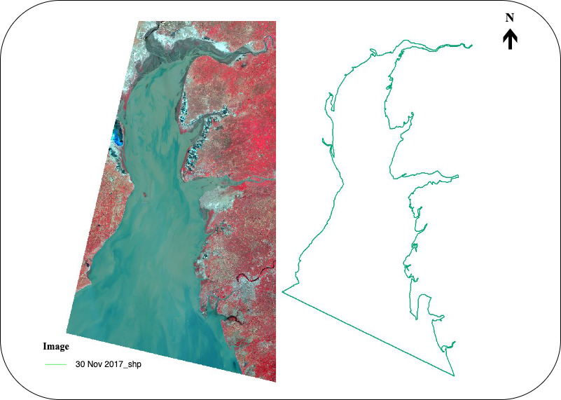
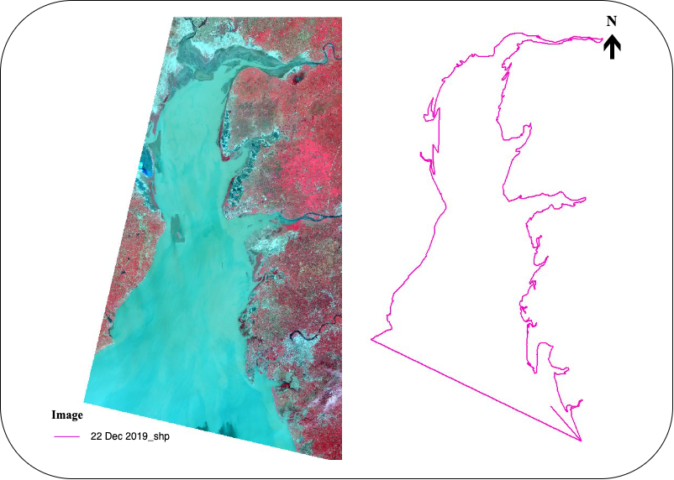
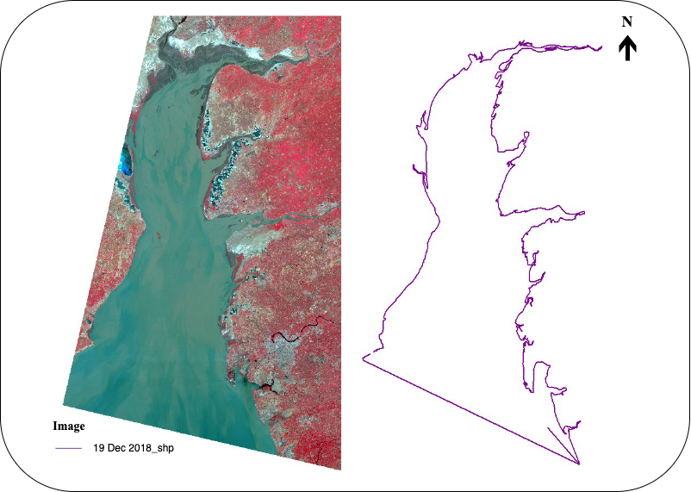
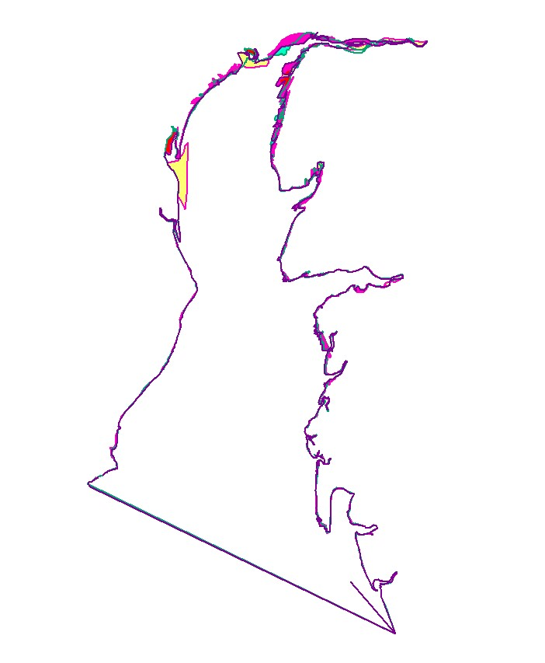
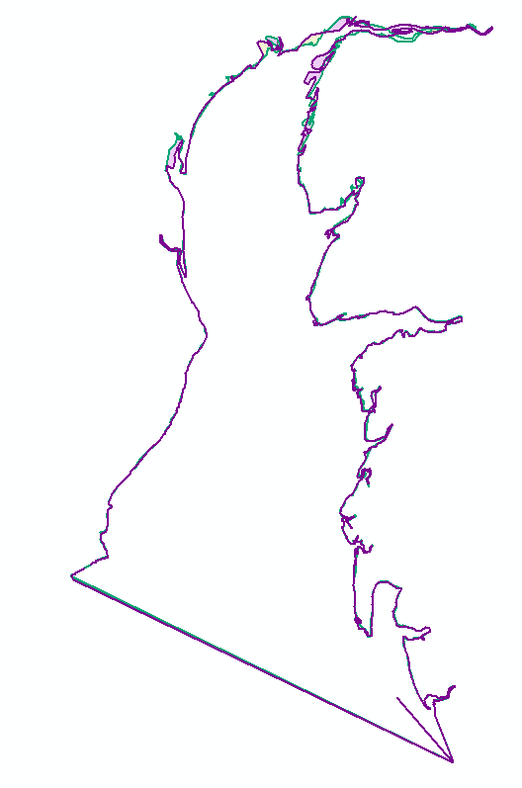
Shoreline Change Analysis for the Gulf of Khambat (2017-2019):
Insights from Erosion and Deposition Areas
Authors : Tanmay, Devasy, Malhar, Wahid
Abstract
Objective
The project aimed to analyze shoreline changes for the Gulf of Khambat for the years 2017, 2018, and 2019. To accomplish this, we downloaded datasets from the USGS website and preprocessed them to form their false-color composite (FCC). Using ArcGIS, we traced the coastline for each of the three years using the Polyline function. Subsequently, we calculated erosion and deposition areas to gain insights into the changes that occurred in the shoreline. The analysis of the data revealed significant shoreline changes in the Gulf of Khambat over the three years, with areas experiencing both erosion and deposition. Our findings provide valuable information that can be used to inform future coastal management strategies. Overall, this project contributes to our understanding of how the Gulf of Khambat shoreline is changing and provides insights into potential environmental impacts.
The objective of this project was to analyze the shoreline changes in the Gulf of Khambat for the years 2017, 2018, and 2019. The specific objectives were to:
Download the required datasets from the USGS website and preprocess them to form their false-color composite.
Use ArcGIS to trace the coastline for each of the three years using the Polyline function.
Calculate erosion and deposition areas for each year to gain insights into the changes that occurred in the shoreline.
Generate insights from the analysis of data that can be used to inform future coastal management strategies.
Contribute to our understanding of how the Gulf of Khambat shoreline is changing and provide insights into potential environmental impacts.
Methodology
Download the required datasets for 2017, 2018, and 2019 from the USGS website.
Preprocess the datasets to form their false-color composite (FCC).
Use ArcGIS to trace the coastline for each of the three years using the Polyline function.
Calculate the erosion and deposition areas for each year using the raster calculator tool in ArcGIS.
Create a map layout in ArcGIS to display the results of the shoreline change analysis.
Generate insights from the analysis of data, including identifying areas of significant erosion or deposition and trends in shoreline changes over time
Write a report summarizing the methodology, results, and insights gained from the analysis.
Expected Results
Identification of areas with significant erosion or deposition
Trends in shoreline changes over the three years
Insights into potential environmental impacts of shoreline changes
Outcomes
Bibliography/ References
1. Patel, K., Jain, R., Patel, A. N., & Kalubarme, M. H. (2021). Shoreline change monitoring for coastal zone management using multi-temporal Landsat data in Mahi River estuary, Gujarat State. Applied Geomatics, 13, 333–347 ².
2. Jodhani, K., Bansal, P., & Jain, P. (2020). Shoreline Change Observations in Gulf of Khambhat using Satellite Images. Proceedings of the 4th International Conference: Innovative Advancement in Engineering & Technology (IAET) 2020 ³.
3. Gupta, M. (2014). Monitoring shoreline changes in the Gulf of Khambhat, India during 1966-2004 using RESOURCESAT-1 LISS-III ⁴.
Overall, the picture of the overlapping shorelines of 3 years can serve as a powerful visual representation of the changes taking place and can help to convey the importance of monitoring and managing shoreline areas.
Acknowledgement
We express our gratitude to our faculty and everyone who helped in making this project possible

